Slide 1

Iterative Compositional Zero-Shot Generation
reporter：吳佩珊
Date: 07/13

Slide 2
CONTENTS
01
Introduction
02
Related works
03
Method
04
Experiment results
05
Conclusion

Slide 3
Part1
Introduction

Slide 4
Background
In computer vision, image generation models—such as VAEs、GANs and diffusion models—are widely used. These models can generate diverse content from inputs like text、labels or images, with applications in style transfer、inpainting enhancement and data synthesis.
Text
Labels
images
Image Generation Models
input
Generated
image
Applications
style transfer
inpainting enhancement
data synthesis
output
4

Slide 5
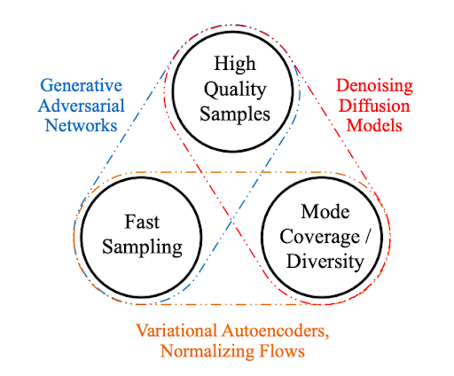
Background
VAE: Although training is stable, the generated images tend to be blurry and less detailed.
GAN: Produces sharper and more realistic images but often suffers from training instability and mode collapse.
Diffusion Models: Generate high-quality and diverse images by gradually denoising, becoming the current mainstream approach in image synthesis.
Limitations of Traditional UNet Architecture: Effective at capturing local image features but struggles with modeling long-range dependencies and complex global context.
Advantages of Transformer Architecture: Excels at capturing global relationships, enhancing image diversity and resolution.
Therefore, our research use Diffusion Transformer (DiT)
5

Slide 6






Research motivation
Limitation of Single-label Conditioning
Training: train DiT with single label y
DiT
Training process
Label$y$
DiT
y∈{White 5, White 6,…., Red 7}
Missing
Training Data
The training dataset does not include such samples,
they can be generated, but their correctness is not guaranteed.
Inference Result
Input condition:
DiT
y∈{White 5, White 6, White 7,
Red 5 , Red 6, Red 7}
Generated image
6

Slide 7







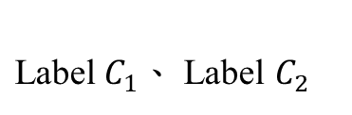
Research motivation
Our previous solution for the limitation
Training: Compositional Conditional DiT
${\text{Label} C}_{1}$、 Label $C_{2}$
Compositional Conditional
DiT
Training process
Compositional Conditional
DiT
${ C}_{1}$: color $∈\left\{\text{White}\text{, }\text{Red}\right\}$
${ C}_{2}$: digit $∈\{5,6,7\}$
Missing
Train dataset
Inference Result
Generating unseen images outperforms the original DiT.
Compositional Conditional
DiT
Input condition:
${ C}_{1}$ $∈\left\{\text{White}\text{, }\text{Red}\right\}$
${ C}_{2}$ $∈\{5,6,7\}$
Problem :
Some generated images are correct,
while others contain noticeable errors.
Generated image
7

Slide 8





Research motivation
The problem of our previous solution
We randomly generate unseen images:
Condition : ${ C}_{1}= Red{ ，C}_{2} \text{=}\text{6}$
Compositional Conditional DiT may generate images that do not satisfy our purpose.
The ratio of good image may be low.
8

Slide 9

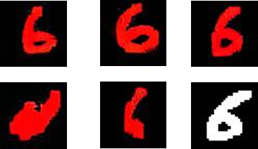
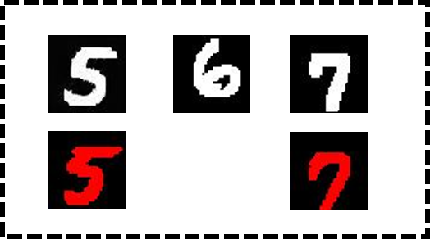

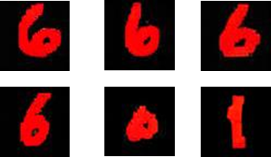
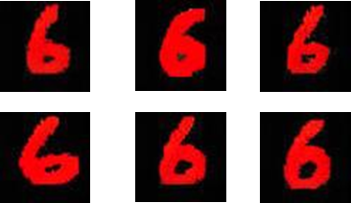


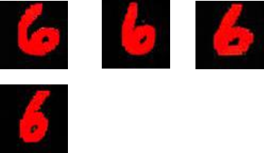
Research motivation
proposal→
Learning from data + Human-in-the-Loop (HITL)
*Because generative AI models may produce hallucinated or factually incorrect content, human-in-the-loop validation is required to guarantee the accuracy of generated images.
Training process
Iteration 1
input
output
Generative Model
Iteration 2
Generated data
Iteration 3
Train dataset
Human selection
Iteration 1
Iteration 2
HITL
Note: Why use human selection?
Large models are constrained by training data, especially in medicine where critical knowledge gaps exist. Expert review ensures accuracy and safety beyond model capabilities.
Performance Evaluation

Slide 10
Research motivation
Proposal challenge
Human-in-the-Loop verification requires manual inspection of each generated sample, which is labor-intensive and time-consuming.
Limited manpower screening leads to class imbalance in the training data.
Possible Solutions
Traditional balanced resampling method for balanced training data
Our method
Modified balanced resampling achieves better generation performance in aforementioned iteration algorithm.

Slide 11
Contribution
Proposed a compositional condition training method within the Diffusion Transformer (DiT) architecture, enables flexible attribute composition and generation of unseen images.
Designed an iterative data generation framework with filtering, which progressively improves the accuracy of unseen image generation while maintaining high sample diversity.
Proposed a gamma-based modified balanced sampling strategy, where sampling weights are recalculated according to the updated class distribution in each iteration.

Slide 12
Part2
Related works
2-1 Iterative Retraining
2-2 imbalance data technology
2-3 Compositional Zero-Shot Learning & generation

Slide 13
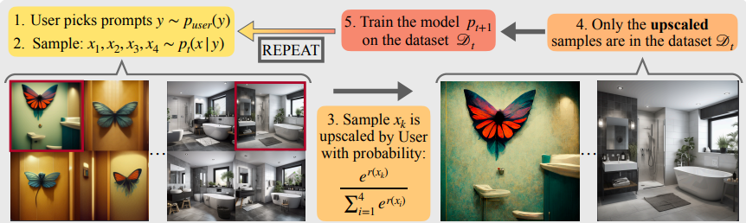
2-1 Iterative Retraining
Self-Consuming Generative Models with Curated Data（Ferbach et al., 2024）
The paper analyzes the impact of data curation on iterative retraining of generative models. It proves that when each training round uses samples curated by a reward model (such as human feedback or preference scores), the retraining process maximizes expected reward. At the same time, maintaining a portion of real data in each round ensures the stability of training.

Slide 14
2-1 Iterative Retraining
Self-Consuming Generative Models with Curated Data（Ferbach et al., 2024）
Theorem 2.1 — Collapse Without Real Data
Theorem 2.2 — Real Data Stabilizes Training
Pure Self-Consuming
→ Mode Collapse to Highest Reward.
Real Data Mixture
→ Local Stability (prevents collapse)
Generated pictures
Real
pictures
Generated pictures
Diffusion model
Diffusion model
Theorem 2.3 — Curation Increases Reward
Real + Curated Data
→ Stable Training + Reward Optimization
Real
pictures
Curated pictures
Generated pictures
Diffusion model

Slide 15
2-2 Imbalance data technology
Resampling
Over-sampling: Repeatedly sampling minority data
→Leads to Over-fitting on synthetic artifacts.
Under-sampling: Under-sampling: Removing majority data
→Results in Loss of General Features and diversity.
Reweighting
Adjusting the loss function based on class frequency
→Difficult to stabilize in iterative generative loops.
In real-world datasets, a few "Majority" classes dominate, while "Minority" or unseen compositional categories are extremely scarce.

Slide 16
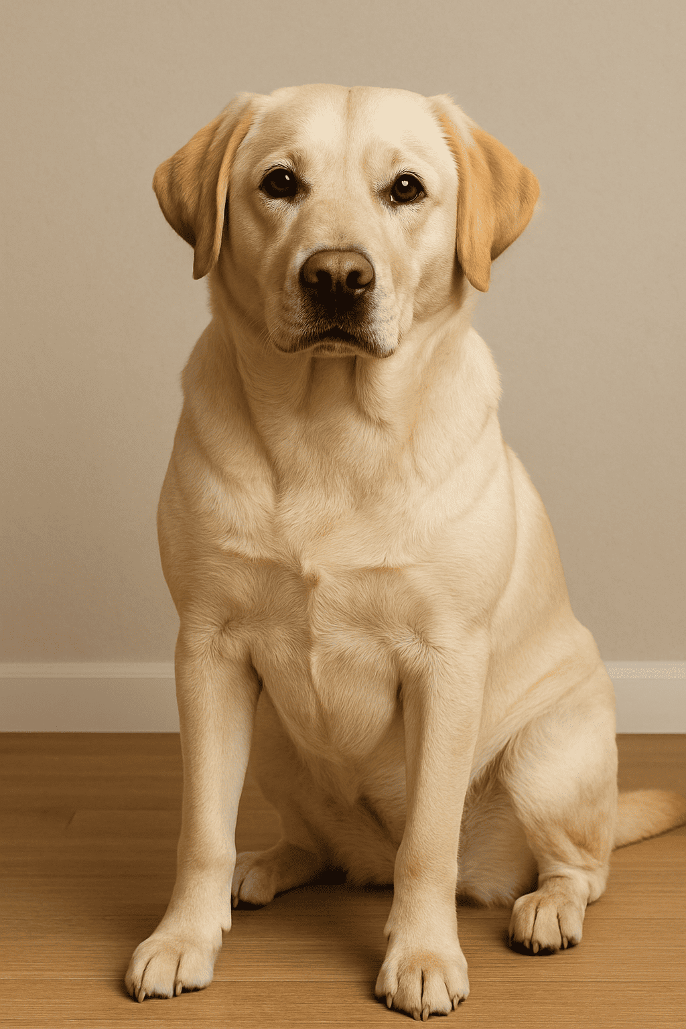
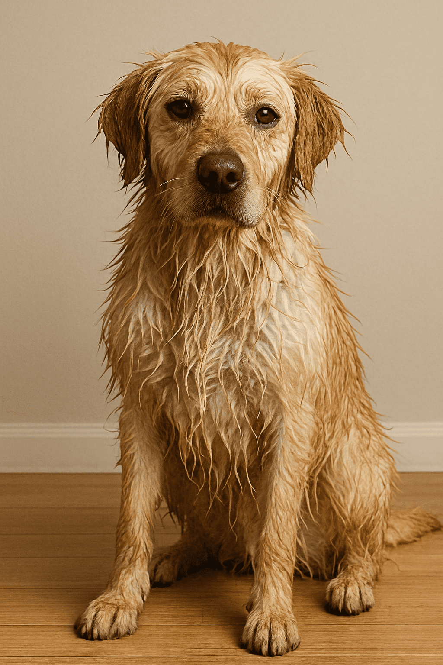
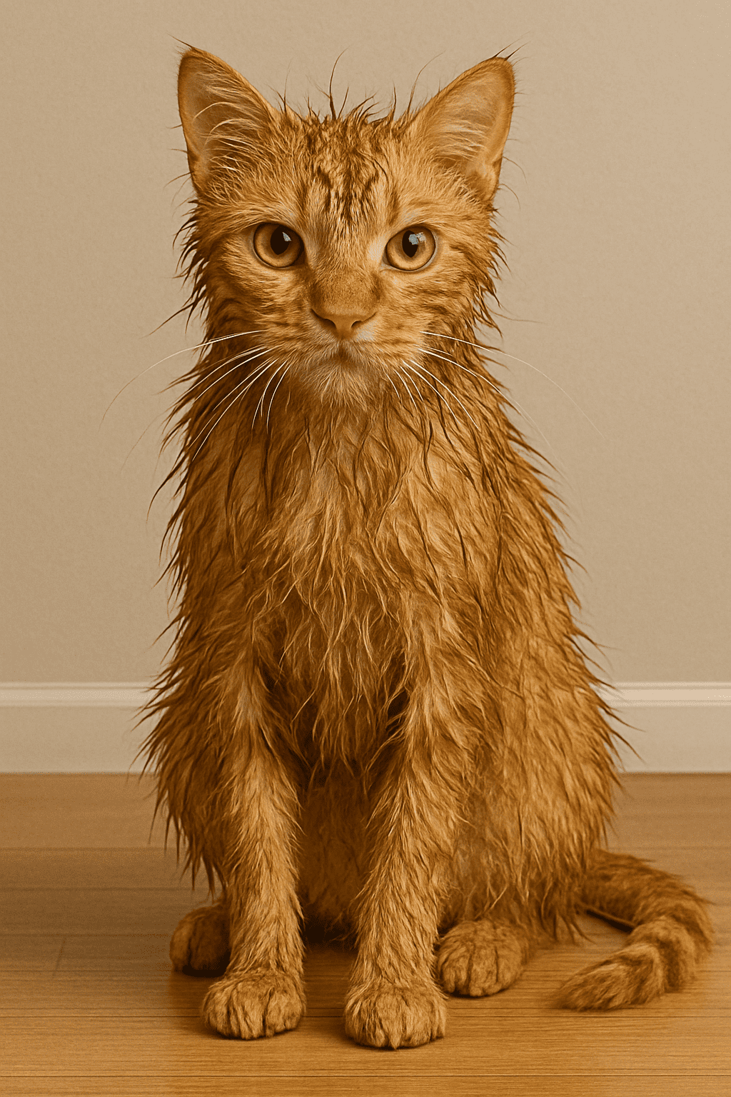
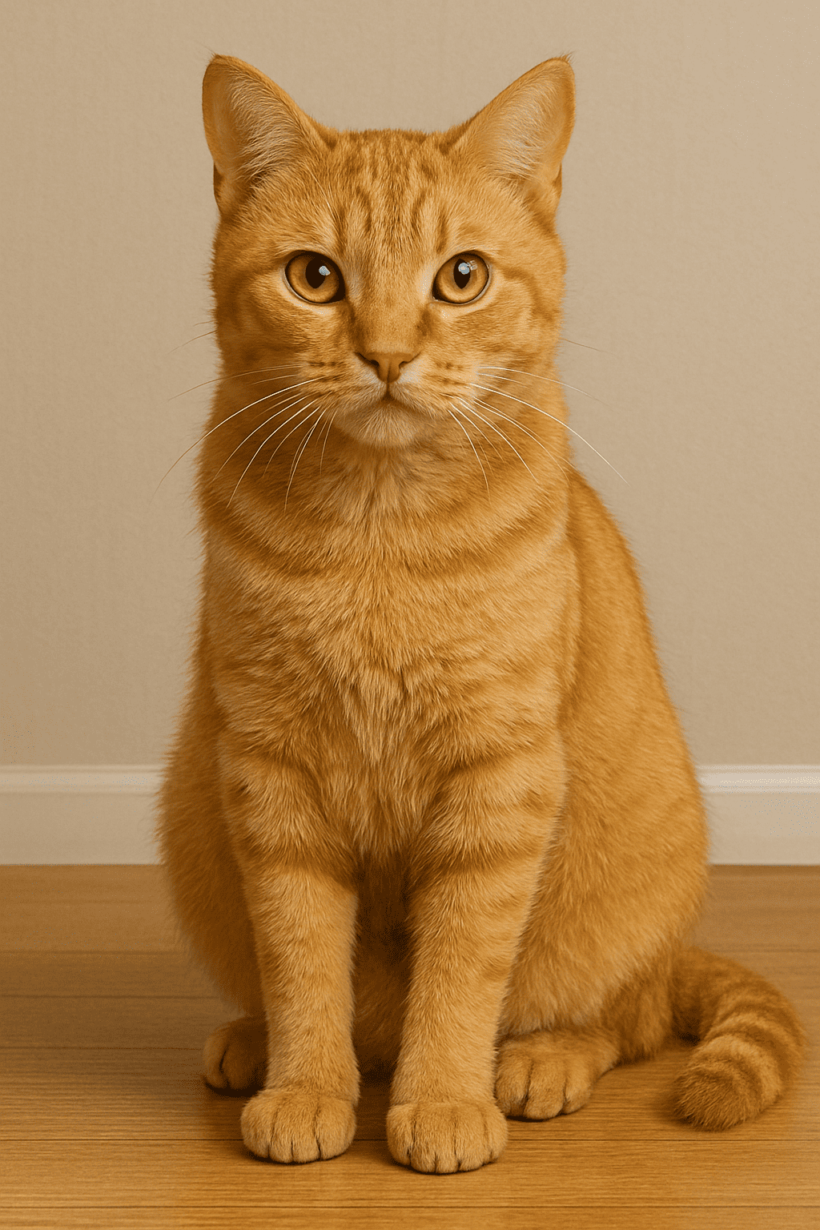
2-3 Compositional Zero-Shot Learning & generation:
Compositional Zero-Shot Learning
Seen Concepts
Unseen Concepts
Image with Unseen Concepts
Object
dog
“dog”
“wet”
“dry”
cat
“cat”
dry
wet
Attribute

Slide 17






2-3 Compositional Zero-Shot Learning & generation:
Compositional Conditional Diffusion Models
Zero shot generation
Pixel Space
Condition Space
$$x_{0}$$
Forward diffusion process
$$x_{T}$$
Time
step $t$
Class
lable 1
. . .
Class
lable n
X (T-1)
Compositional
class label c
Denoising model $ε_{θ}$
$$\overline{x_{0}}$$
Conditioning module
…
Conditioning module
$$x_{T}$$
Timestep
encoder
Compositional class encoder
In our method，
we replace the U-Net backbone with a Transformer backbone.
+ iterative retraining +modified balanced resampling

Slide 18
Part3
Method
3-1 Sampling Strategy
3-2 Compositional DiT Model
3-3 Data diversity evaluation

Slide 19
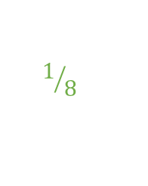
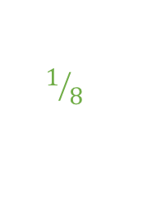
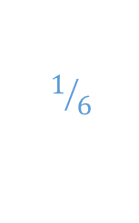





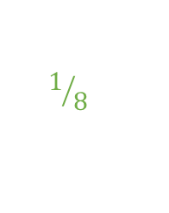

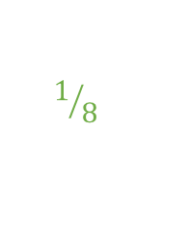
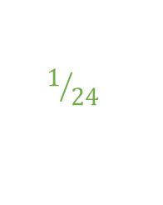

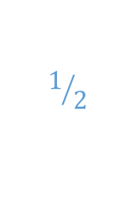
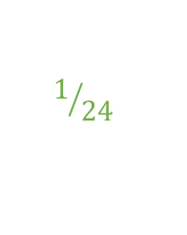
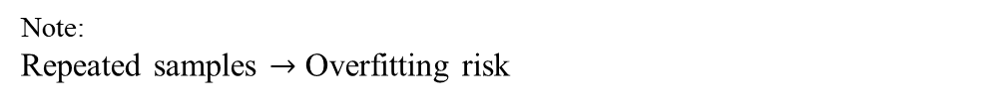


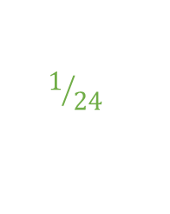

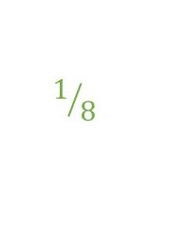

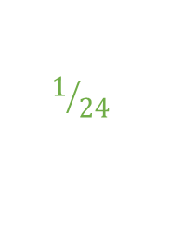



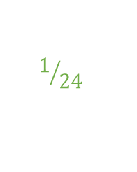


3-1Sampling Strategy (1/2)
: Why we need balance?
Initial dataset
Assume the dataset contains three categories (classes).
Class-Probability
calculation
$$1/2$$
$$1/4$$
$$1/4$$
$$1/8$$
$$1/8$$
$$1/8$$
$$1/8$$
Probability
$$1/2$$
$$1/4$$
$$1/4$$
$$1/8$$
$$1/8$$
$$1/8$$
$$1/8$$
$$1/6$$
$$1/{12}$$
$$1/{12}$$
$$1/{24}$$
$$1/{24}$$
$$1/{24}$$
$$1/{24}$$
p= probability /probability.sum()
p
$$1/6$$
$$1/{12}$$
$$1/{12}$$
$$1/{24}$$
$$1/{24}$$
$$1/{24}$$
$$1/{24}$$
∑ p_{i}​=Number of Classes
⚠️
Random sampling with p
Note:
Repeated samples $→$ Overfitting risk
Dataset after sampling

Slide 20
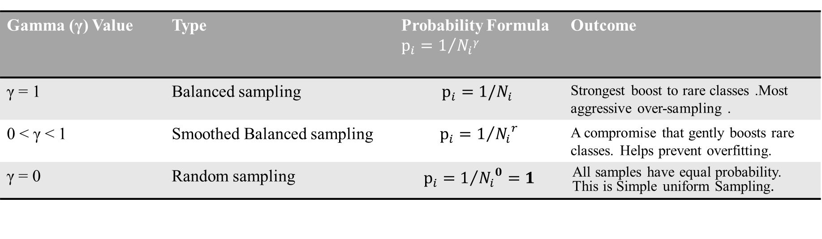
3-1 Sampling Strategy (2/2)
: Proposed Modified Balanced Sampling
Smoothed Probability with γ
*N: number of samples per class
Gamma (γ) Value | Type | Probability Formula $$p_{i}=1/{N_{i}γ}$$ | Outcome
γ = 1 | Balanced sampling | $$p_{i}={1/N}_{i}$$ | Strongest boost to rare classes .Most aggressive over-sampling .
0 < γ < 1 | Smoothed Balanced sampling | $$p_{i}=1/{{N_{i}}^{r}}$$ | A compromise that gently boosts rare classes. Helps prevent overfitting.
γ = 0 | Random sampling | $$p_{i}=1/{{N_{i}}^{0}=1}$$ | All samples have equal probability. This is Simple uniform Sampling.
Final Sampling Probability : p= probability /probability.sum()
Random sampling with p
Dataset after sampling

Slide 21
3-1Sampling Strategy (2/2)
: Proposed Modified Balanced Sampling
Algorithm1 : Modified Balanced Sampler
Input: Dataset 𝒟 of size N, labels L corresponding to each sample in D, Smoothing parameter γ, seed s, epoch e Output: An iterator of N sample indices. Initialize: Count Class Frequency: Calculate class_counts for each unique class in L. Calculate Sample probabilities: i. For each sample i with class label c: prob_i ← 1 / (class_counts[c] ^ γ) ii. Store all probabilities in a list P. Normalize Probabilities: Create a probability distribution P ← P / sum(P). Generate Indices: a. Set Seed: Use a seed for the current epoch (seed = s + e) to ensure reproducibility b. Weighted Random Sampling: Generate a list indices by sampling N indices from {0, ..., N-1} with replacement, using the probability distribution P. c. Shuffle (Optional): If enabled, shuffle the indices list to further randomize the order. d. Return an iterator for the indices list.
In our experiments, we evaluate different balancing strengths by setting γ = 0、0.3、0.5、 0.7 and 1.

Slide 22
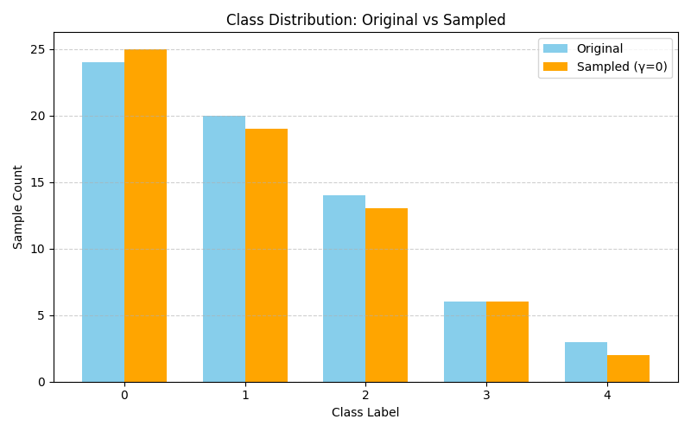
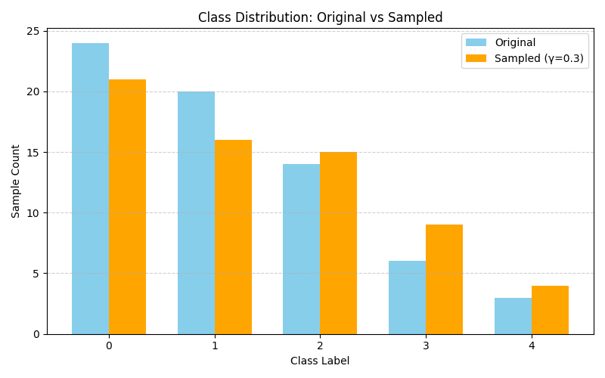
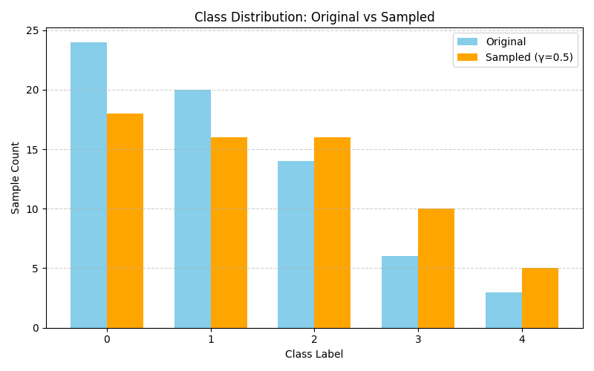
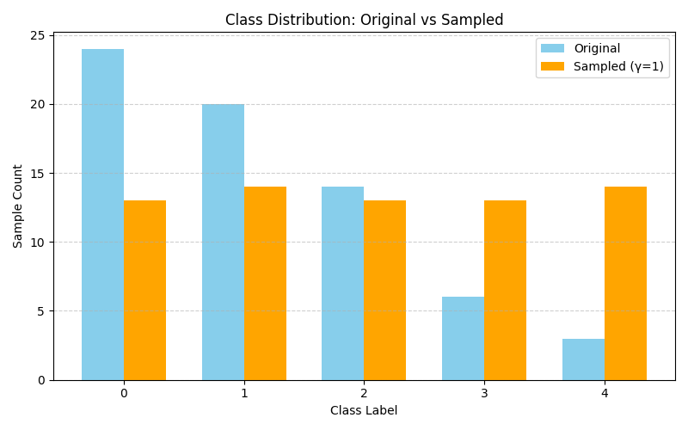
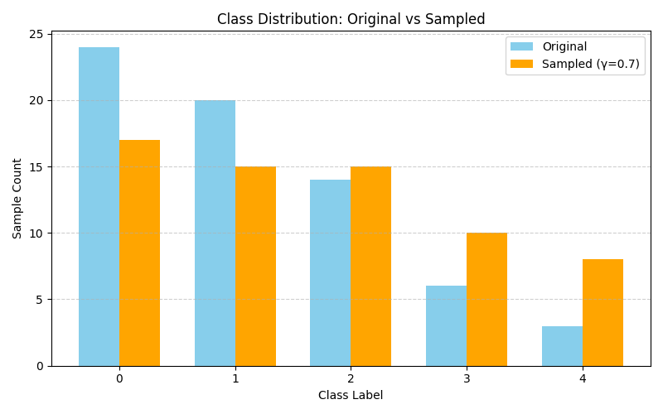
3-1Sampling Strategy (2/2)
: Proposed Modified Balanced Sampling
Visualizing Class Sampling Distribution under Different Gamma (γ) Values
(γ=0)
(γ=0.3)
(γ=0.5)
(γ=1)
(γ=0.7)

Slide 23











3-2 Compositional DiT Model
: Model Architecture Overview
Pixel Space
Lower-Dimensional Latent Space
Condition Space
$$Z_{0}$$
$$Z_{T}$$
$$t$$
$$c_{1}$$
$$c_{2}$$
$$x_{0}$$
encoder
Forward diffusion process
X (T-1)
$$Z_{T}$$
Patchify
Input
Tokens
Noise
DiT Block
Timestep
Embedder
Label
Embedder
Label
Embedder
$$Z_{T−1}$$
Linear and reshape
DiT Block
$$\overline{x_{0}}$$
$$Z_{0}$$
Layer Norm
decoder
Σ
Conditioning
Conditioning module
X
$$N$$

Slide 24
3-2 Compositional DiT Model
: Label Embedder
Class ID(index): C_{i} ∈ {0,1,...,K-1}
Embedding table
Class embedding
Null token ID:K(for CFG dropout)
W ∈${ \text{R}}^{(K+1)×d}$

Slide 25
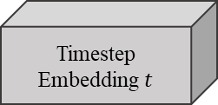
3-2 Compositional DiT Model
: Conditioning module
Class-Attribute
Embedding C1
DiT block
MLP
C
Class-Object
Embedding C2
Timestep Embedding $t$
C
concatenation
element-wise addition

Slide 26

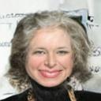




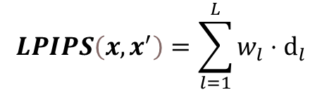

3-3 Data diversity evaluation
Evaluation metrics for diversity-Learned Perceptual Image Patch Similarity(LPIPS)
VGG
L2 (Euclidean) distance:
$$\left\{{ f}_{1}\left(x\right),f_{2}\left(x\right),⋯f_{L}\left(x\right)\right\}$$
$$ⅆ_{l}={\left\|\hat{f_{l}}\left(x\right)−\hat{f_{l}}\left(x^{′}\right)\right\|}_{2}^{2}$$
$$x$$
Extract features
from different CNN layers
$$LPIPS\left(x,x^{′}\right)=\sum_{l=1}^{L}{w_{l}}⋅ⅆ_{l}$$
VGG
$$\left\{{ f}_{1}\left(x^{′}\right),f_{2}\left(x^{′}\right),⋯f_{L}\left(x^{′}\right)\right\}$$
*Pretrained on ImageNet dataset
$$x^{′}$$

Slide 27
Part4
Experiment result
4-1 Experiment Setup
4-2 Evaluation metrics
4-3 Experiment results

Slide 28
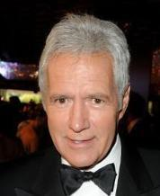
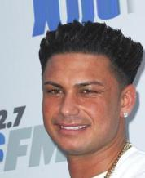
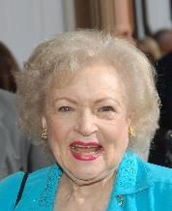
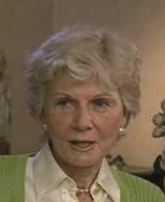
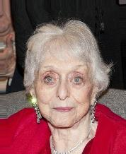
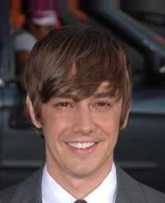
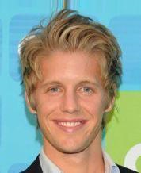
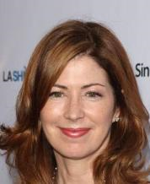
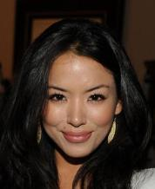
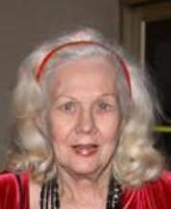
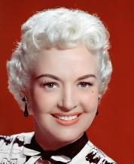


4-1Experiment Setup:
CelebA(CelebFace Attributes Dataset)
CelebA is a large-scale public face dataset, containing over 200,000 celebrity images.
Each image is annotated with 40 binary attribute labels(e.g., gender、hair color、smiling).
attribute
Target for Generation
<Gray Hair , Female>
Brown Hair Blond Hair Gray Hair Black Hair
Male
Female
object
unseen
Training set
Gray-Hair Female is excluded from the training set and treated as an unseen combination.

Slide 29
4-1Experiment Setup:
CelebA(CelebFace Attributes Dataset)
attribute
Target for Generation
<Gray Hair , Female>
Brown Hair Blond Hair Gray Hair Black Hair
Male
Female
12638 1676 6644 19621
object
20900 24358 0 19960
Training set
Gray Hair Female is excluded from the training set and treated as unseen.

Slide 30





















4-1Experiment Setup:
CelebA(CelebFace Attributes Dataset)
We generate images from unseen target attribute combinations and manually verify whether
they match the target condition.
Pass
Fail(Does not match the target condition)
Selected images are added to the training set for the next
*For γ = 0.3, 0.5, and 0.7, we omit the Iteration 1 experiment because unseen images have not yet been added,
which makes class imbalance less severe at this stage.

Slide 31

4-2 Evaluation metrics
How do we evaluate ?
Quantitative Analysis
The correctness ratio= $\frac{\text{number} \text{of} \text{manually} \text{selected} \text{correct} \text{images} }{ \text{number} \text{of} \text{randomly} \text{generated} \text{unseen}\text{−}\text{type} \text{images}}$
$$LPIPS\left(x,x^{′}\right)=\sum_{l=1}^{L}{w_{l}}⋅ⅆ_{l}$$
Evaluation metrics for diversity :
In addition to the quantitative evaluation above, we also use t-SNE for qualitative analysis.
Qualitative Diversity Evaluation
Step 1. Resize all generated images to 128 × 128
Step 2. Extract visual features using the intermediate layer of an ImageNet-pretrained VGG16
Step 3. Obtain a feature vector for each generated image
Step 4. Project high-dimensional features into 2D using t-SNE
Step 5. Visualize different iterations or γ values with different colors valuation above

Slide 32
4-3 Experiment results
Quantitative Analysis
of Iterative Training on CelebA Dataset
*Note:
For γ = 0.3、0.5、0.7 , we start from Iteration 2,
using Iteration 1 (γ = 1) output as input
The training dataset for Iteration 3 is constructed from the updated dataset
after image generation by each γ in Iteration 2.
 | Random Sampling(γ=0) | Modified Balanced Sampling(γ=0.3) | Modified Balanced Sampling(γ=0.5) | Modified Balanced Sampling(γ=0.7) | Balanced Sampling(γ=1)
Iteration 1 | 473 (9.46%) | - | - | - | 622 (12.44%)
Iteration 2 | 1085 (21.7%) | 1231 (24.62%) | 1123 (24.16%) | 1132 (22.64%) | 1065 (21.3%)
Iteration 3 | 1579 (31.58%) | 1641 (32.82%) | 1588 (31.76%) | 1751 (35.2%) | 1708 (34.16%)
As more images are added, adopting a more balanced sampling strategy (larger γ) leads to better generation performance.
When only a few additional images are included, smaller values of γ are preferred.

Slide 33
4-3 Experiment results
Quantitative Analysis
of Iterative Training on CelebA Dataset
*Note:
For γ = 0.3、0.5、0.7 , we start from Iteration 2,
using Iteration 1 (γ = 1) output as input
The training dataset for Iteration 3 is constructed from the updated dataset
after image generation by each γ in Iteration 2.
LPIPS
 | Random Sampling(γ=0) | Modified Balanced Sampling(γ=0.3) | Modified Balanced Sampling(γ=0.5) | Modified Balanced Sampling(γ=0.7) | Balanced Sampling(γ=1)
Iteration1 | 0.5339 | - | - | - | 0.5596
Iteration2 | 0.5276 | 0.5346 | 0.5269 | 0.5082 | 0.5333
Iteration3 | 0.4461 | 0.4967 | 0.4675 | 0.4614 | 0.5117

Slide 34

4-3 Experiment results
Qualitative Analysis
of Iterative Training on CelebA Dataset
 | Random Sampling(γ=0) | Modified Balanced Sampling(γ=0.3) | Modified Balanced Sampling(γ=0.5) | Modified Balanced Sampling(γ=0.7) | Balanced Sampling(γ=1)
Iteration2 | 0.5276 | 0.5346 | 0.5269 | 0.5082 | 0.5333
When the diversity score is higher, the t-SNE points are more spread out, whereas lower diversity scores lead to more compact clusters. In this figure, the case with γ=0.7 has a lower diversity score and appears noticeably more concentrated in the t-SNE plot.
a. t-SNE of Iteration2

Slide 35

4-3 Experiment results
Qualitative Analysis
of Iterative Training on CelebA Dataset
 | Random Sampling(γ=0) | Modified Balanced Sampling(γ=0.3) | Modified Balanced Sampling(γ=0.5) | Modified Balanced Sampling(γ=0.7) | Balanced Sampling(γ=1)
Iteration3 | 0.4461 | 0.4967 | 0.4675 | 0.4614 | 0.5117
γ = 1: Dispersed (High Diversity)
γ = 0: Concentrated
(Low Diversity)
b. t-SNE of Iteration3

Slide 36
























4-3 Experiment results
Balanced Sampling(γ=1)
Balanced Sampling(γ=1)
<Gray Hair , Female>
<Gray Hair , Female>
By strategically reducing diversity, our method significantly boosts generation accuracy
1.Selected Images from Iteration 1
LPIPS:0.5596
Accuracy:12.44%
3.Selected Images from Iteration 3
LPIPS:0.5117
Accuracy:34.16%

Slide 37
Part5
Conclusion

Slide 38
Conclusion
This study presents an iterative compositional DiT framework for unseen attribute-object image generation. The model uses attribute and object conditions to guide latent diffusion with a Transformer backbone.
By combining curated iterative retraining and gamma-based modified balanced sampling, the proposed method progressively improves target-condition correctness while maintaining reasonable sample diversity. Experiments on CelebA show that gamma sampling provides a flexible way to balance generation accuracy and diversity under dynamic class imbalance.

Slide 39
Thanks for listening!

Slide 40
Appendix

Slide 41






Experiment Setup:
Mnist Color Dataset
To demonstrate the model's ability to generate unseen images, we first conducted a preliminary test on a simpler toy dataset , where combinations along the diagonal (e.g., <Zero, White>) were held out as unseen data.
attribute
Target for Generation
0 1 2 3 4
<Zero, White>
<One, Red>
<Two, Green>
<Three, Blue>
<Four, Yellow>
White
Red
Green
object
Blue
Yellow
Training set

Slide 42

Experiment Results:
Mnist Color Dataset - sample

Slide 43
Classifier
Ablation Study: Impact of Generated Data
Classifier 1: Real data only → Baseline performance
Classifier 2: Real + Generated → Improved accuracy by X%
drop
no
Attribute(Condition1)
Binary Classifier
Correct
Attribute?
yes
Take intersection
Of two Conditions
Test data 𝐷₂
Object(Condition2)
Binary Classifier
Correct
Object?
yes
no
drop

Slide 44
Classifier
Iteration 2
Iteration 3
Use 1000 Gray_Hair Female images as Test data 𝐷₂
score classifier | Condition1 Number of corrects | Condition2 Number of corrects | Composition Number of corrects
Baseline | 230 | 949 | 205
Balanced Sampling | 286 | 935 | 244
Balanced Sampling | 349 | 957 | 322
Uniform Sampling | 280 | 951 | 245
Uniform Sampling | 234 | 946 | 203
Modified Balanced Sampling (gamma=0.5) | 381 | 939 | 339
Modified Balanced Sampling (gamma=0.5) | 391 | 948 | 353
Modified Balanced Sampling (gamma=0.3) | 361 | 929 | 310
Modified Balanced Sampling (gamma=0.3) | 397 | 927 | 350
Modified Balanced Sampling (gamma=0.7) | 354 | 932 | 313
Modified Balanced Sampling (gamma=0.7) | 400 | 915 | 344

